Slide 2
Session 7: Horizontal Issues – IPR, RRI, Ethics, Open Science
Proposal Writing Camp

Slide 3
Intellectual Property Rights - IPR
Proposal Writing Camp

Slide 4
Intellectual Property rules
The IP rules in Horizon Europe can be found in:
  the Rules for Participation
  the (model) Grant Agreement
  the applicable work programme
  Online Manual (IP section is a work in progress)
How to find them: Funding & Tenders Portal
https://ec.europa.eu/info/funding-tenders/opportunities/portal/screen/how-to-participate/reference-documents

Slide 5
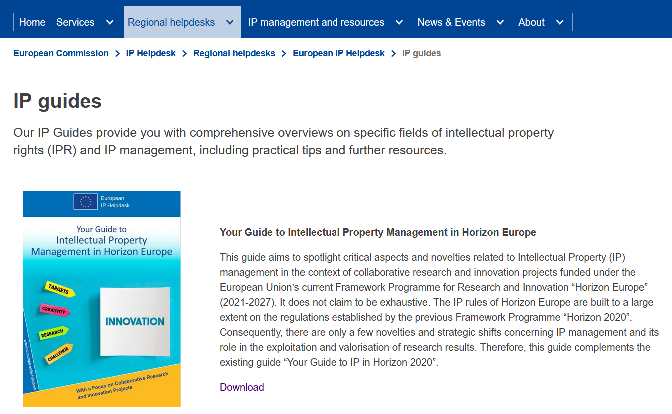
Intellectual Property Guide – by IPR Helpdesk
https://intellectual-property-helpdesk.ec.europa.eu/regional-helpdesks/european-ip-helpdesk/ip-guides_en

Slide 6
Intellectual Property rules
Background
  Tangible or intangible input (data, knowhow, information) which is held by the project partners prior to their accession to the GA. Includes IP such as copyright, patents /patent applications (filed prior to access to GA).
  Rule: taking part in Horizon projects does not have any influence upon the ownership of background = your background remains yours!
Results
  All results which are generated under the project – whether or not protectable. Such results may include copyright, design or patent rights, trademarks or others, and belong to the partners who have generated them.

Slide 7
Intellectual Property rules
Access rights
User rights (incl. licences) to results or background of project partners.
Exploitation
  Utilisation (direct /indirect) of results in research activities, which are not part of the project, as well as utilisation for further development, creation and commercialisation of a product or service.
Dissemination
  Public disclosure and transfer of project results with the aim to enable others to use and take up results, thus maximising the impact of EU-funded research. Targeted audiences that may take an interest in the potential USE of the results (e.g. scientific community commercial partner, policy makers).

Slide 8

IP management in Horizon Europe - Process
Proposal stage
Background held prior to the project by the participants, which is needed and identified
Project
Results are generated in the project
Accession
Background is used in the project
Grant agreement
Exploitation of results: further research, open licence, spin-off/start-up, etc.

Slide 9

IP management in Horizon Europe – what to remember
  Background: The consortium partners identify and agree on the background for the project and how to use this in the project
  Ownership of the results: In Horizon Europe, generally the Grant Agreement establishes that the results of the project belong to the participant generating them
  General obligation to exploit: Each beneficiary must take measures to ensure the exploitation of its results, in particular through transfer or licensing, for up to four years after project completion
  Costs of IP protection are Horizon Europe project eligible costs: Costs related to intellectual property which occurred during the project implementation, can be eligible for reimbursement. Include them in the proposal budget!

Slide 10
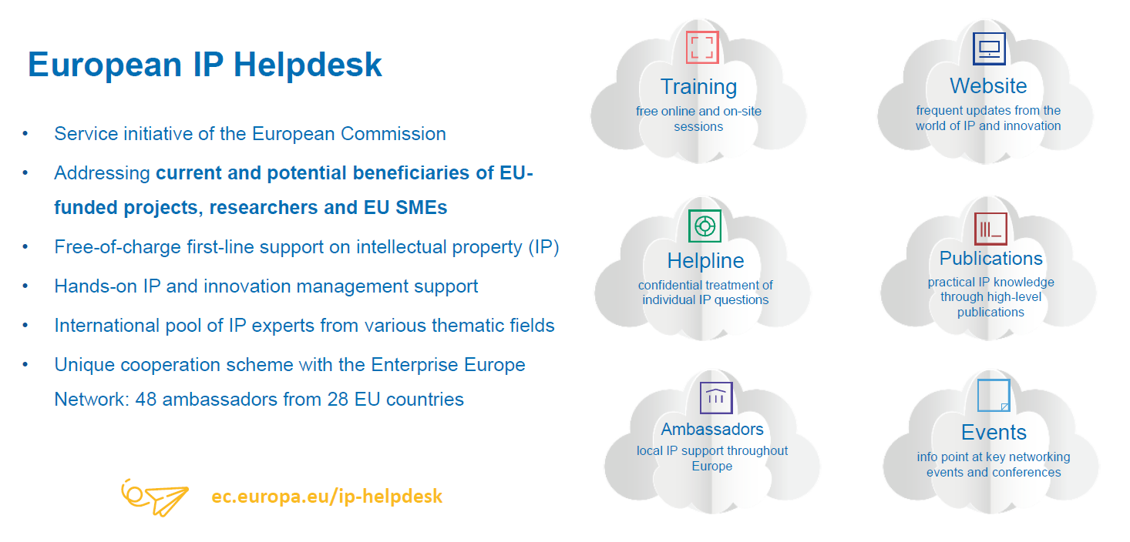
https://intellectual-property-helpdesk.ec.europa.eu/index_en

Slide 11
Responsible Research and Innovation - RRI
Proposal Writing Camp

Slide 12
Responsible Research and Innovation - RRI
  RRI is an approach which intends to bridge gaps between science, research and innovation communities and society at large by fostering more inclusive, anticipatory, open and responsive research and innovation systems.
  six key elements of RRI:
  ethics,
  gender equality,
  governance,
  public engagement,
  science education,
  and open access

Slide 13
Ethics
Proposal Writing Camp

Slide 14
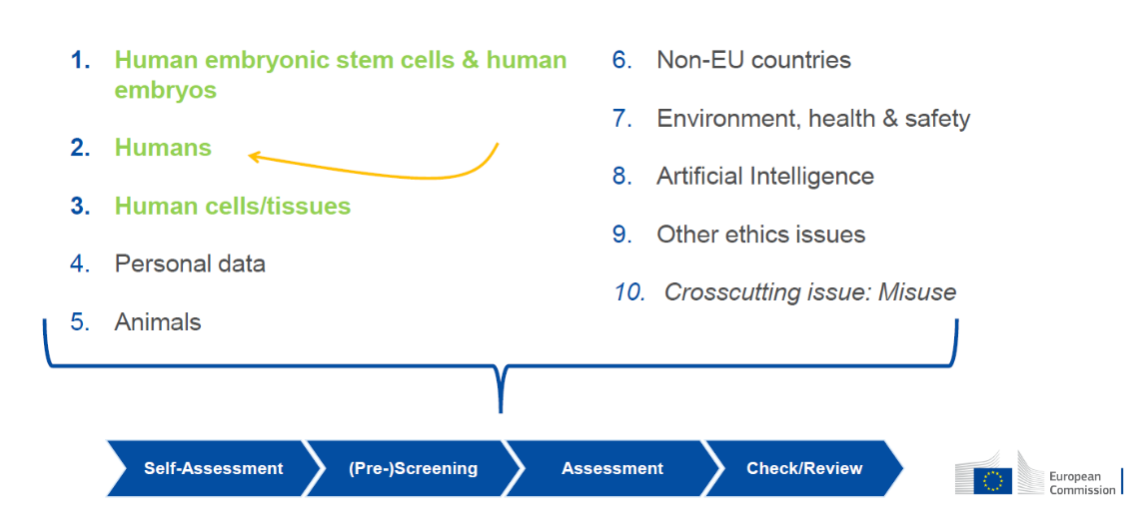
The Ethics Issues

Slide 15
Ethics
  Examine
  Part A of the proposal: the Ethics Issues Table, the Ethics Self Assessment, list of participants
  Part B of the proposal: containing the proposed activities, workplan, ethics annexes (if necessary)

Slide 16
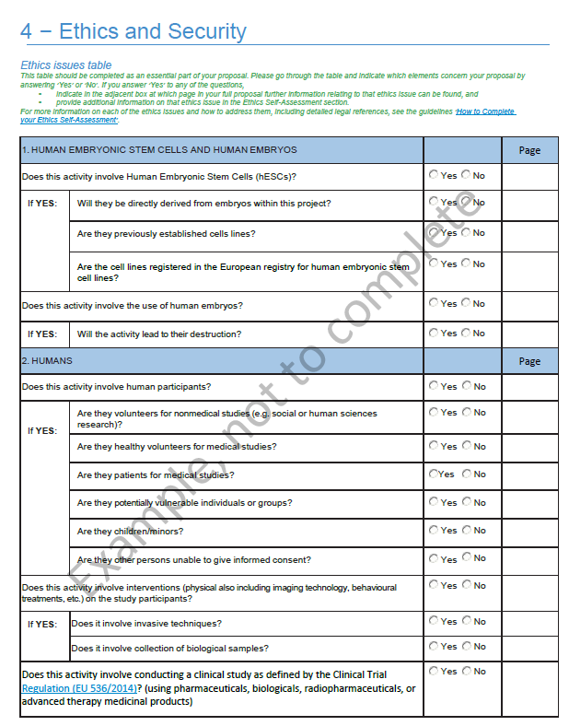
Part A
Ethics Issues Table

Slide 17
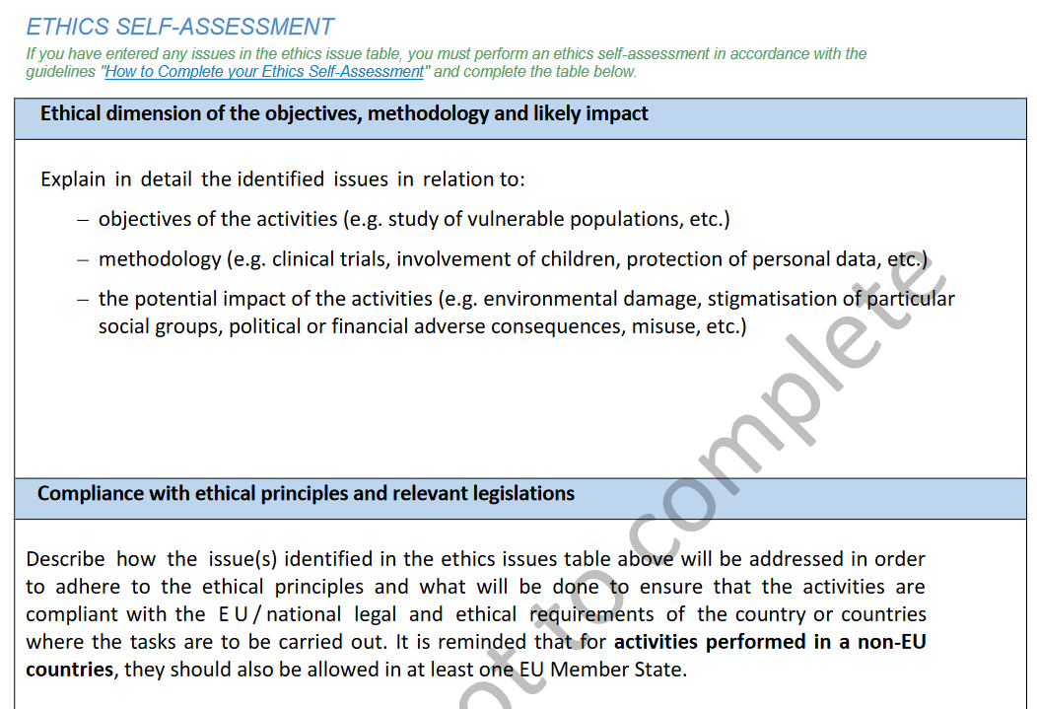
Part A
Ethics
Self Assess-ment

Slide 18
How to complete your Ethics Self-Assessment
  Guide with information and advice on how to address ethics in research / Horizon Europe
  https://ec.europa.eu/info/funding-tenders/opportunities/docs/2021-2027/common/guidance/how-to-complete-your-ethics-self-assessment_en.pdf
  For ALL applicants (NOT only medical research)
  Fill-in the Ethics issues table and sections for ethics self-assessment in Part A of the submission system
  If necessary, an annex to Part B on ethics can be added, e.g. Additional information on clinical studies as Annex in Part B

Slide 19
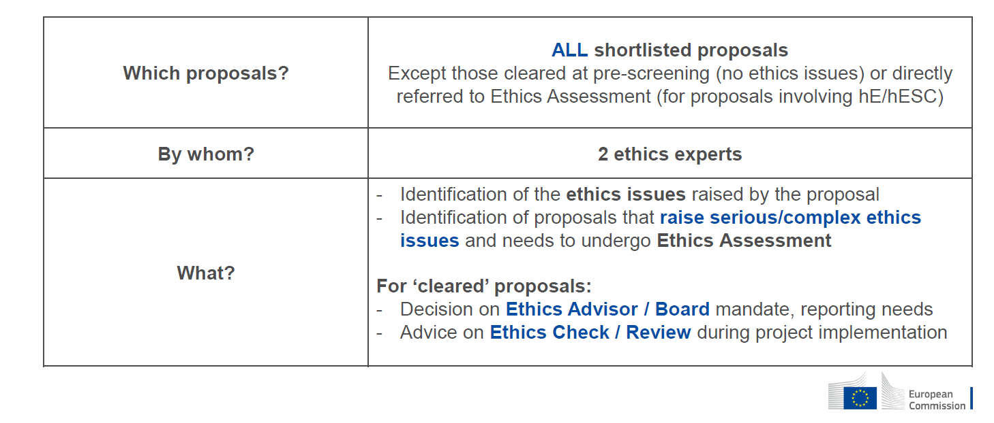
The Ethics Screening of Proposals

Slide 20
Open Science
Proposal Writing Camp
“Open science” means an approach to the scientific process based on open cooperative work, tools and diffusing knowledge
(Horizon Europe Regulation and Model Grant Agreement)

Slide 21
Open Science Practices in Horizon Europe
  early and open sharing of research (for example through preregistration, registered reports, pre-prints, or crowd-sourcing)
  research output management including research data management (RDM)
  measures to ensure reproducibility of research outputs
  providing open access to research outputs (e.g. publications, data, software, models, algorithms, and workflows) through deposition in trusted repositories
  participation in open peer-review
  involving all relevant knowledge actors including citizens, civil society and end users in the co-creation of R&I agendas and contents (such as citizen science)

Slide 22
Open Science – Open access to scientific publications
  Beneficiaries must ensure Open Access (OA) to peer-reviewed scientific publications relating to their results;
  Immediate open access through trusted repository (at the latest at the time of publication);
  information via the repository about any research output/tools/instruments needed to validate the conclusions of the scientific publication
  Only publication fees (if any) in full open access venues for peer-reviewed scientific publications are eligible for reimbursement
  Metadata must be open in line with the FAIR principles (Findable, Accessible, Interoperable and Re-usable)

Slide 23
Open Science – Research Data Management (RDM)
  Beneficiaries must manage the research data generated in the action responsibly, in line with the FAIR principles
  establish + regularly update a data management plan (‘DMP’) for generated (and/or collected) data; by M6 of project;
  as soon as possible and within the deadlines set out in the DMP, deposit the data in a trusted repository;
  follow the principle ‘as open as possible as closed as necessary’, i.e. there can be exceptions to open access to research data.
  Costs for RDM (for example data storage, processing and preservation) are eligible

Slide 24

Open Research Europe:
A high-quality, reliable and efficient open access publishing venue for EU-funded research
Launched in March 2021 for H2020 and HE beneficiaries
High scientific standards (e.g. editorial policies+guidelines), expert Scientific Advisory Board across all fields of science
Swift publication times and transparent processes (e.g. open peer-review) No cost to authors/beneficiaries (publication fees paid by the Commission)
Optional: no obligation to publish there: but if you do, you comply with HE policy
https://open-research-europe.ec.europa.eu/

Slide 25
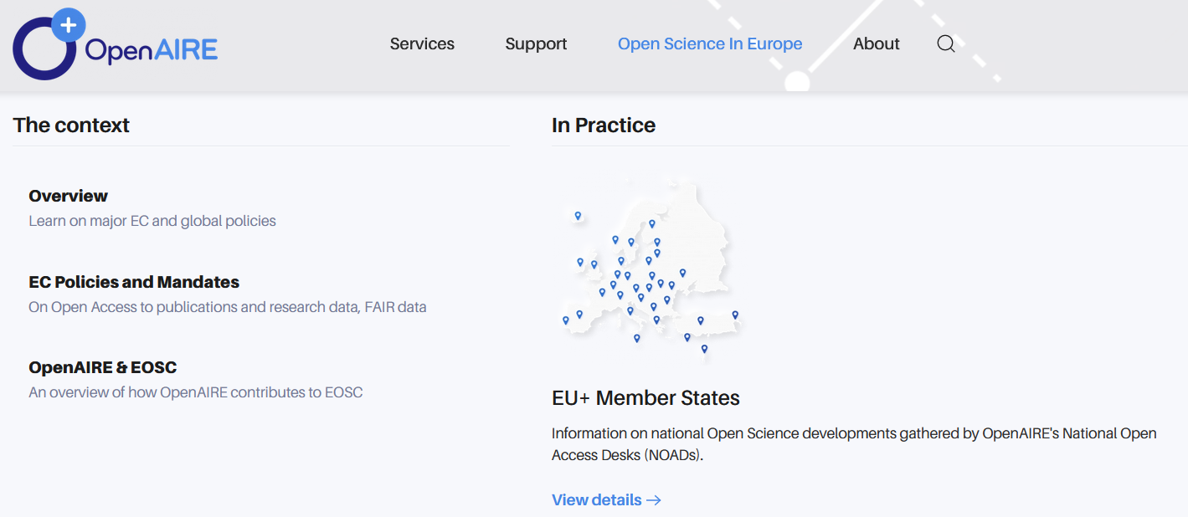
OpenAIRE - Services for Open Science https://www.openaire.eu/

Slide 26
Horizontal Issues - Group Work
Proposal Writing Camp

Slide 27
Identify for your proposal key aspects of…
IPR – Intellectual property rights
RRI - Responsible Research and Innovation
Ethics
Open science
  Challenges you see?
  Opportunities created by action?
  What needs to be done to integrate the issues adequately in your project?

Slide 28
Contact us!
George Bonas george.bonas@ceriss.eu
Inna Petrenko ipetrenko@enrich-global.eu

Slide 29
Thank you!
#HorizonEU
http://ec.europa.eu/horizon-europe

